Slide 1

DATA ANALYSIS

Slide 2



MEET THE TEAM 08
DATA SCIENTIST
DATA ANALYSIST
AI ENGINEEER
TARAKA NAGA GANESH
SURYA TEJ PATTEM
BINAYA DHAKAL

Slide 3
BUSINESS PROBLEM
Content creators lack clear insights into what makes YouTube video trend quickly and engages audiences . The gap in understanding leads to suboptimal content strategies , impacting overall video performance on the platform. A systematic, data driven solution is needed to empower in optimizing their content effectively

Slide 4
PROPOSED SOLUTION
Implement a data-driven solution leveraging AWS services to analyze YouTube data . Provide content creators with actionable insights, visualizations, and optimization recommendations, empowering them to enhance engagement.

Slide 5
BUSINESS QUESTIOIN
Current optimization :
Question : What specific element in video content significantly impact rapid trendiness and sustained engagement ?
Geographic Tailoring :
Question : How can content creators tailor their videos based on geographic variations to maximize audience in different regions?
Optimal Timing and Length :
Question : What are the optimal times, days and video lengths for publishing content to ensure higher visibility and trendiness ?

Slide 6

THE SOLUTIONS
CONTENT OPTIMIZATION
GEOGRAPHIC TAILORING
OPTIMAL TIMING AND LENGTH
Data Analysis :
Engaging titles, relevant tags.
Sentiment Analysis :
Understanding audience reactions.
Analyze Regional Data :
identify preferences.
Tailor Content :
Cultural references , trending topics.
Time-series Analysis:
Peak hours and days.
Length Trends :
Optimal duration for engagement

Slide 7
DATA OVERVIEW
SOURCE :
Attributes : In depth details includes video title, channel information, publication time, tags, views , likes, dislikes, description and comment count .
Categories : videos categorized with a unique identifier (category_id) that varies across to the dataset.
Storage : Centralized in Amazon S3, ensuring scalable, secure, and efficient access to the dataset .
Objective : Facilitate detailed analysis to uncover pattern and trends, understanding the factors influencing video trendiness and engagement on the YouTube platform
https://www.kaggle.com/datasets/datasnaek/youtube-new

Slide 8
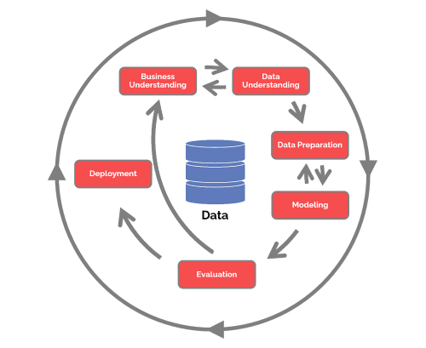
METHODOLOGY CRISP-DM

Slide 9
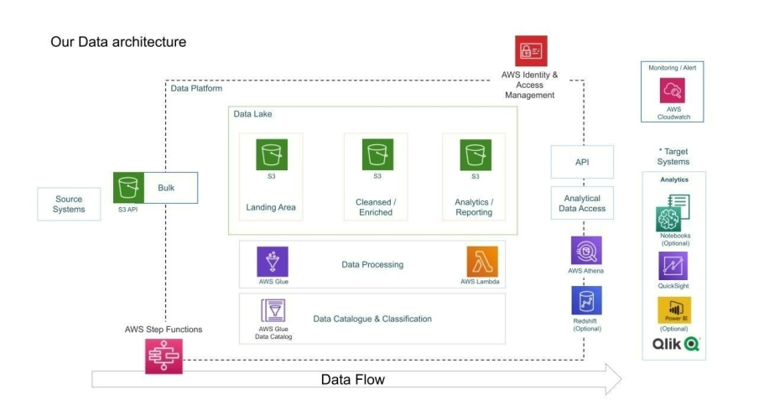
TECHNOLOGIES

Slide 10
PATH TO INTEGRATION
Data Setup and Transformation
AWS Integration and Analysis
Documentation, training and Feedback
> Acquire Kaggle dataset fro YouTube videos.
> Employ AWS Glue for data transformation.
> Establish a centralized data lake on Amazon S3 for efficient storage
> Ensure scalability with AWS services.
> Implement serverless processing using Lambda.
>Utilize Athena for interactive querying and apply machine learning techniques for insightful analysis.
>Integrate Amazon Quick Sight for creating interactive dashboards and visualization.
> Document the data processing pipeline for reference.
> Conduct training sessions for stakeholders to interpret insights.
> establish a continuous feedback loop for content creators, adapting analyses based on emerging trends.
>Evalute project outcomes, refining processes for further optimization

Slide 11
COMPETITIVE ANALYSIS
Informed Decision-Making with Data
Comprehensive Understanding of success factor
Efficiency, Scalability and continuous improvement
The project empowers content creators through detailed data analysis and machiine learning insights by delving into video attributes, sentiment and trends creators can make informed decision, aligning their content with what resonates most with their audience.
Leveraging AWS services ensures scalability,security and efficient processing of vast datasets. the establishment of a user feedback loop allows for continuous improvemnet, adapting analyses based on real time feedback and evolving trnds , creating a dynamic and efficient content optimization strategy
The project takes a holistic approach, offering into content optimization, geographic preferences and optimal timing. this comprehensive understanding enables creators to strategically tailor their content for maximum impact and engageent

Slide 12


Slide 13

Thank you!

